Slide 1
Multilingual Mental Health Chatbot
Ahmed Elsayed
Your One-Click Away Mental Well-Being Companion

Slide 2
Table of contents
01
02
03
04
05
Importance of Mental Well-being
Why Therapy Matters
Bridging the Gap with Technology
Introduction
06
07
08
Project Overview
Technical Framework
Data Preparation
Model Training
09
10
12
11
System Flow
Demo
Future Work
Conclusion

Slide 3
What do you think is the biggest barrier to seeking mental health support?

Slide 4
01
Introduction

Slide 5
Mental health definition
Mental Health is a state of mental well-being that enables people to cope with the stresses of life, realize their abilities, learn well and work well, and contribute to their community. It is an integral component of health and well-being that underpins our individual and collective abilities to make decisions, build relationships and shape the world we live in

Slide 6
02
Importance of well-being

Slide 7
—Harold H. Bloomfield
“The less harshly we judge ourselves, the more accepting we become of others.”

Slide 8
World Health Organization (WHO) estimates that:
globally 1 out of every 4 people will be impacted by mental illness at some point in their lives.
350 million people worldwide suffer from depression
each year an estimated 700,000 people take their own lives – compared to 619,000 people killed by malaria!
Based on those stats, Mental well-being is not a luxury to be over-seen.
Mental well-being is vital for overall health, influencing our thoughts, feelings, and actions.
It enhances resilience, stress management, and relationships, while also linking to better physical health and longevity.

Slide 9
03
Why Therapy Matters

Slide 10
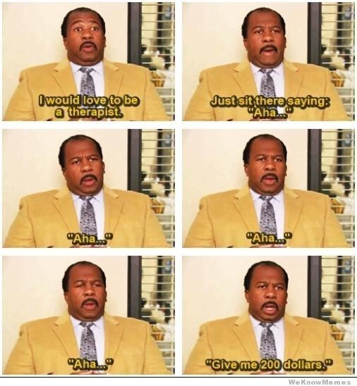
Challenges with Traditional Therapy
Therapy offers a safe space for individuals to express emotions, understand their thoughts, and learn coping strategies.
It has been proven effective for treating conditions such as anxiety, depression, PTSD, and more.
Access to professional therapy can be limited due to cost, availability, and Wrong perception about therapy session.
Language barriers make it difficult for non-native speakers to find a therapist who understands them.

Slide 11
04
Bridging the Gap With Technology

Slide 12
How Technology Can Help
AI and chatbots can provide immediate, anonymous support, especially in regions with limited access to therapy.
Multilingual capabilities ensure people receive help in their preferred language, making mental health support more inclusive.
Introducing Our Project
This is where our Multilingual Mental Health Chatbot comes in, leveraging advanced AI to offer empathetic and context-aware support to those in need.

Slide 13
05
Project Overveiw

Slide 14
Project Idea
A Multilingual Therapist Chatbot for providing mental health support.
The chatbot should offer empathetic, contextually relevant, and helpful advice.
It mimics a therapist's responses to various mental health states.
It responds in the same language as Patient’s input

Slide 15
06
Technical Framework

Slide 16
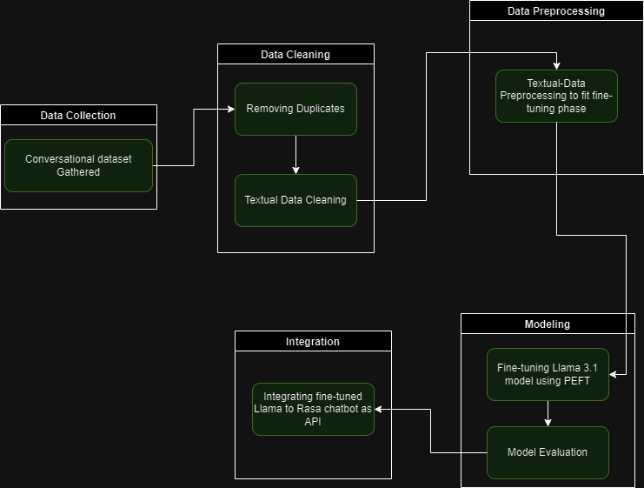
Tools and Libraries
Pipeline
Pytorch
PEFT
Unsloth
Transformers
Hugging Face
Numpy
Pandas
Rasa Framework

Slide 17
07
Data Preparation

Slide 18
Dataset Source: Amod/mental_health_counseling_conversations Datasets at Hugging Face.
Dataset Description: This dataset is a collection of questions and answers sourced from two online counseling and therapy platforms. The questions cover a wide range of mental health topics, and the answers are provided by qualified psychologists.

Slide 19
08
Model Training

Slide 20
Llama 3.1 Fine-Tuning for Mental Health Support
The goal was to adapt Llama 3.1 to provide contextually relevant and empathetic responses for users seeking mental health support
Dataset Preparation: We utilized the dataset 'Amod/mental_health_counseling_conversations' from Hugging Face. This dataset contains diverse conversational scenarios that mimic real-life therapy sessions.
Data Preprocessing:
Tokenization: We tokenized the text data to prepare it for the model.
Normalization: Text was cleaned to remove any noise, such as excessive whitespace or irrelevant symbols.
Training Environment: The model was fine-tuned using PyTorch, which allowed for efficient computation on GPUs, significantly reducing training time.

Slide 21
Parameter-Efficient Fine-Tuning (PEFT):
Definition: PEFT is a technique that allows us to fine-tune only a small number of parameters in a pre-trained model, making the process faster and less resource-intensive.
Benefits:
Resource Efficiency: It requires less memory and computational power, allowing for faster experimentation and iteration.
Reduced Overfitting: By fine-tuning fewer parameters, we help maintain the model’s generalization capability, reducing the risk of overfitting to the training data.

Slide 22
09
System Flow

Slide 23
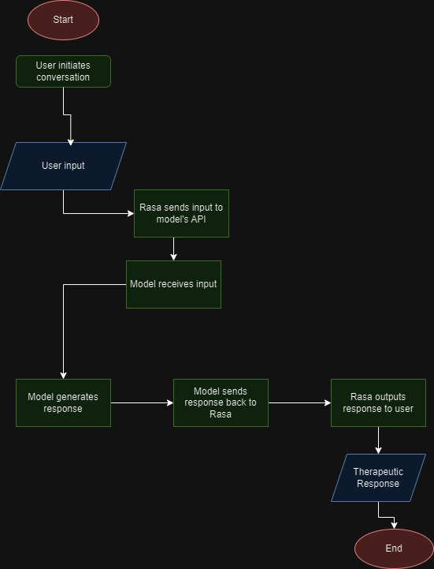
Flow Diagram

Slide 24
10
Demo

Slide 25

Computer mockup
You can replace the image on the screen with your own work. Just right-click on it and select “Replace image”

Slide 26
11
Future Work

Slide 27
Future Enhancements
1. Expansion to More Languages:
Goal: To add much stronger support for languages such as Arabic and Japanese, increasing the chatbot’s reach to non-English-speaking populations effectively.
Approach: Fine-tune using non-English therapy counseling datasets to improve multilingual support.
2. Enhanced Emotional Intelligence:
Goal: To improve the chatbot’s ability to detect subtle emotional cues and adapt responses accordingly.
Approach: Integrate advanced emotion detection models that analyze tone and word choice, providing more personalized support.

Slide 28
12
Conclusion

Slide 29
Project Recap
We developed a multilingual mental health chatbot using Llama 3.1 and the Rasa framework, aimed at offering empathetic and context-aware support.
Key Takeaways
Our chatbot can serve as a valuable tool in areas with limited access to mental health professionals, reducing barriers to seeking help.
With the capacity for multilingual support, it can reach a diverse audience, providing culturally sensitive and contextually relevant advice.
By offering immediate responses, the chatbot can assist in de-escalating distressing situations, giving users a safe space to express their feelings.

Slide 30
Thanks!
Do you have any questions?
ahmedelsayedtaha467@gmail.com
+201211335175
Please keep this slide for attribution

